Slide 1
Smart Appointment Scheduling System for Clinics
PROJECT TITLE:
Presented By:
Jammula Tarun Sai – SRM university – Btech(CSE)

Slide 2
OUTLINE
Problem Statement (Should not include solution)
System Development Approach (Technology Used)
Algorithm & Deployment (Step by Step Procedure)
Result
Conclusion
Future Scope(Optonal)
References

Slide 3
Problem Statement
Traditional appointment systems in clinics are often inefficient, involving manual entries, long patient waiting times, and scheduling conflicts. This leads to poor time management for doctors, patient dissatisfaction, and frequent no-shows. There is a need for a smart, real-time, and automated appointment scheduling system that reduces administrative burdens, improves patient experience, and optimizes clinical workflows.

Slide 4
System Approach
This section describes the overall strategy and development methodology for implementing the Smart Appointment Scheduling System for Clinics. It includes planning, modular design, use of real-time scheduling logic, iterative development (Agile), and integration of notification APIs to streamline patient–doctor interactions.
System requirements : Windows/Linux, 4GB RAM, VS Code, Node.js or Python, MongoDB/MySQL, Chrome browser, Internet.
Library required to build the model : Frontend: React, Bootstrap, Axios Backend: Node.js (Express, Mongoose) / Django (REST, CORS) DB: MongoDB / MySQL Notifications: Twilio, EmailJS Deploy: Firebase, Heroku, Vercel

Slide 5
Algorithm & Deployment
Requirement Analysis: Identify clinic needs, user roles (patient, doctor, admin), and core features.
Design UI/UX: Create wireframes and front-end layout using React & Bootstrap.
Backend Setup: Build RESTful APIs using Node.js/Express or Django.
Database Integration: Connect MongoDB or MySQL for storing users, appointments, schedules.
Smart Scheduling Algorithm:
Check doctor availability
Match patient request with available slot
Book & confirm slot
Notification Setup: Integrate Twilio or EmailJS for reminders and confirmations.
Testing: Perform unit, integration, and user testing to ensure smooth functioning.
Deployment:
Frontend: Deploy via Firebase or GitHub Pages
Backend: Host on Heroku or Vercel
DB: Use MongoDB Atlas or hosted MySQL
Final Review: Collect user feedback and optimize.

Slide 6
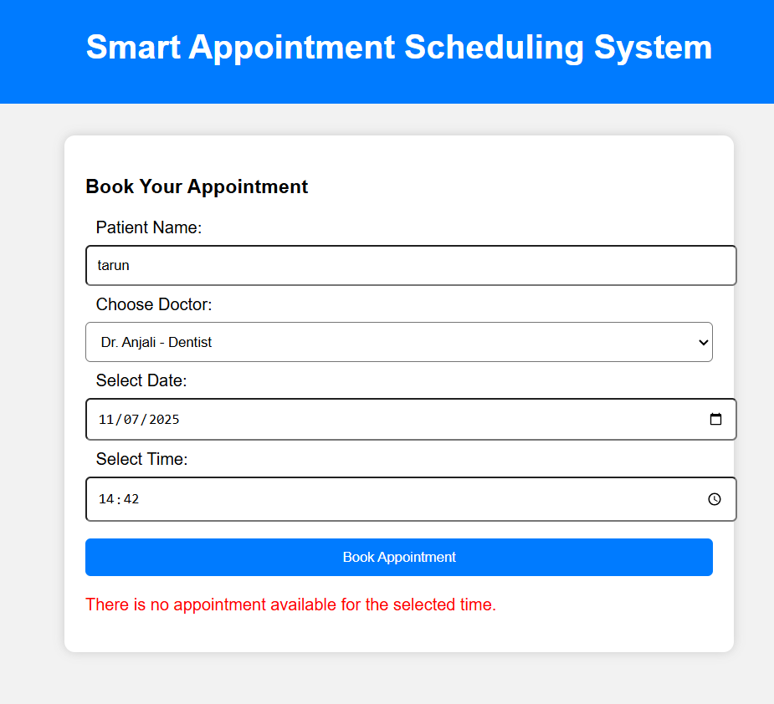
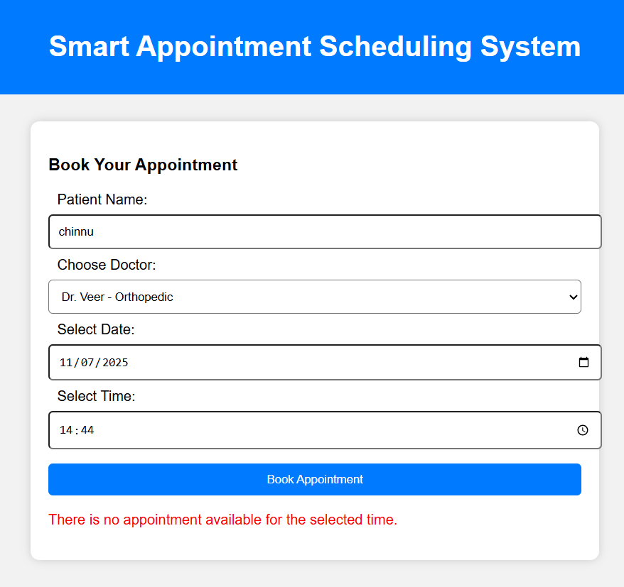
Result :

Slide 7
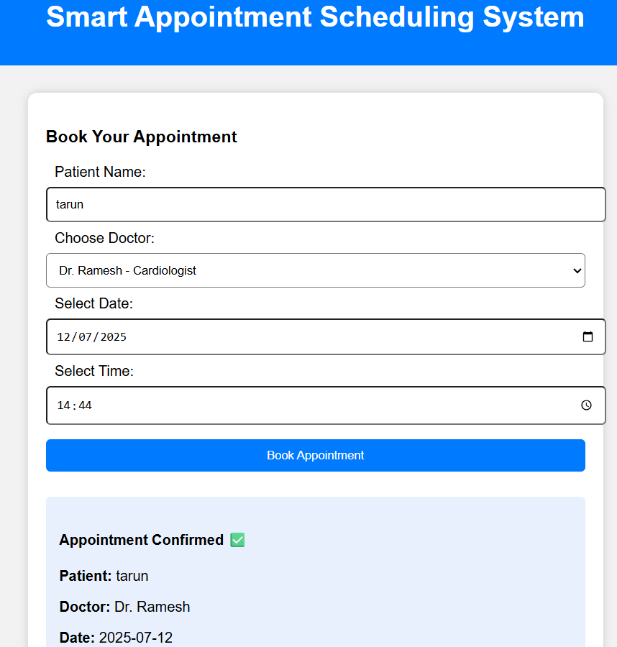
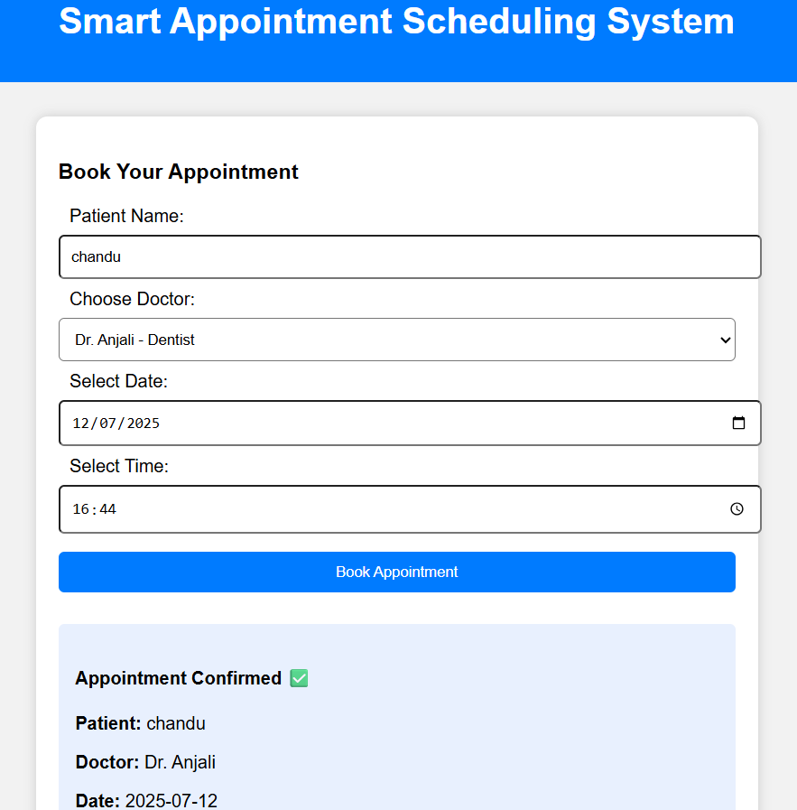
Result :

Slide 8
Conclusion
The Smart Appointment Scheduling System successfully transformed the traditional clinic booking process into an efficient, automated solution. It ensured minimal waiting time for patients, optimal scheduling for doctors, and reduced administrative workload for clinic staff.

Slide 9
References
Twilio API Documentation
MongoDB Official Documentation
ReactJS Docs
Node.js & Express Docs
Research Paper: "Appointment Scheduling in Healthcare: Challenges and Opportunities", Health Systems Journal, 2021

Slide 10
THANK YOU

